Slide 1


All Aboard!
Lessons from BCCs first year experience courses

Slide 2

Corequisite model
EG 101(Comp. 1) → EG 060 (dev. course)
Developmental students attend EG 101 with traditional students and then follow same teacher into EG 060 immediately after.
Some students may also take an additional reading course during the same term, but that course is not paired with the others.

Slide 3

Essential Question
How can developmental courses take full advantage of their position as first-semester courses?

Slide 4



Introducing PDX
PD 121 - ENGAGING IN BUS AND INDUSTRY
PD 122 - ENGAGING IN FINE ARTS AND COMM
PD 123 - ENGAGING IN HEALTH SCIENCES
PD 124 - ENGAGING IN THE HUMANITIES
PD 125 - ENGAGING IN PUBLIC SERVICES
PD 126 - ENGAGING IN SCI, ENG, MATH
PD 127 - ENGAGING IN SOC/BEH SCIENCES
PD 129 - ENGAGING META MAJORS/PATHWAYS

Slide 5
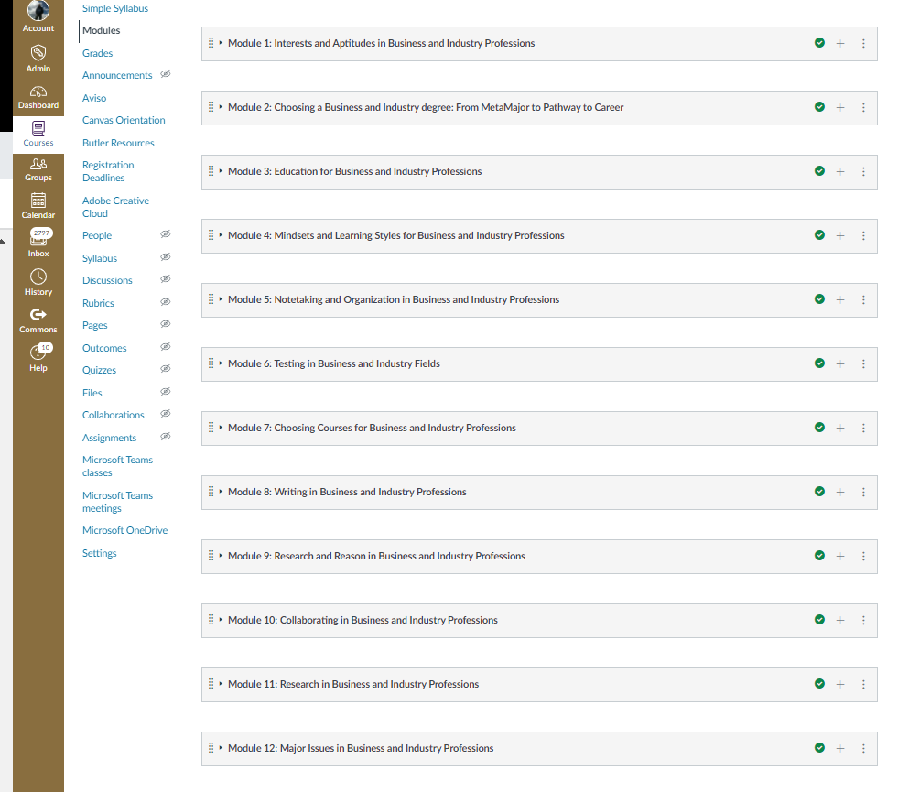
Introducing PDX

Slide 6



Slide 7



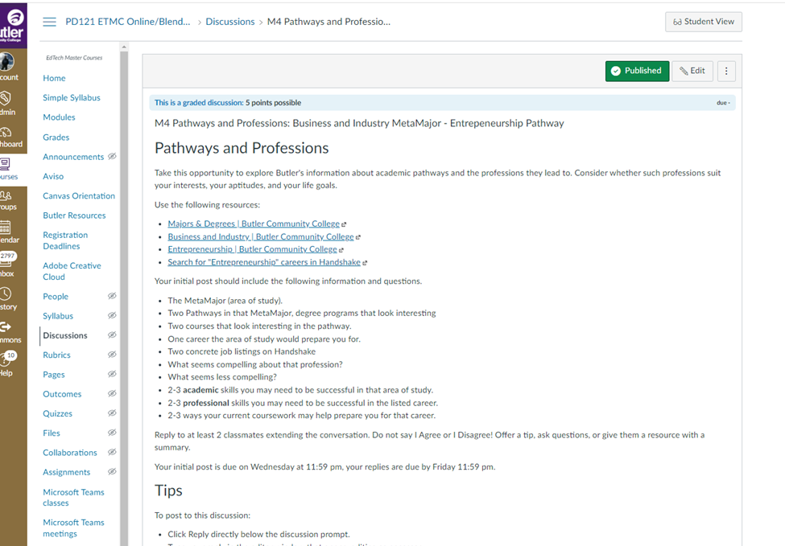
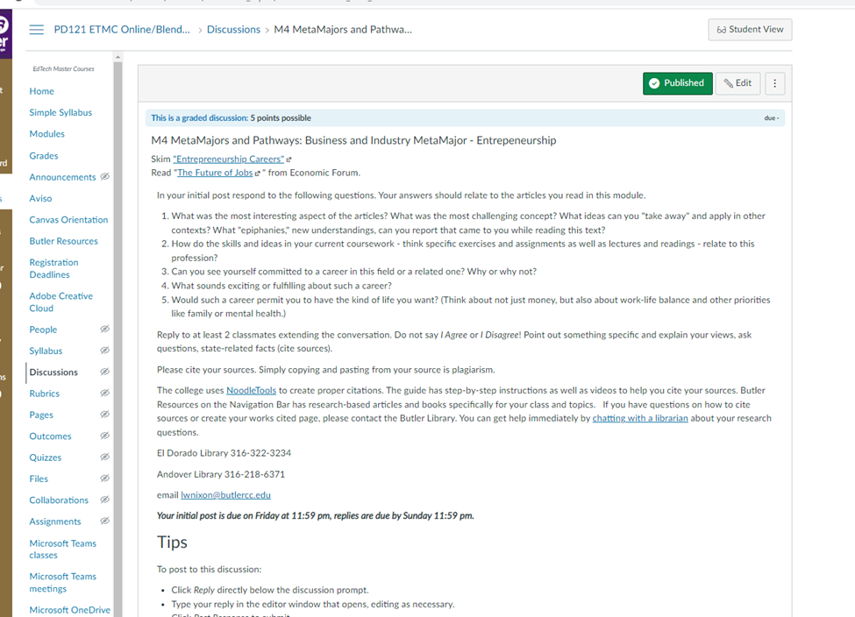
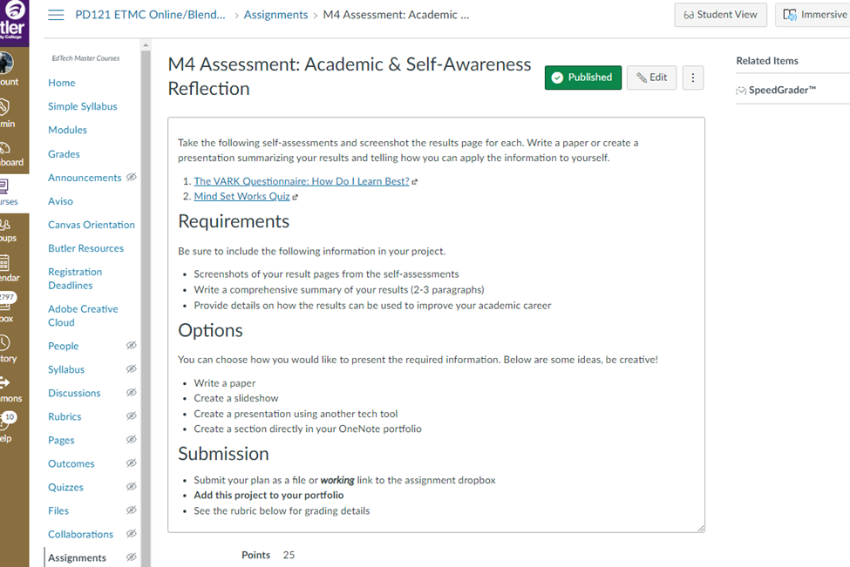
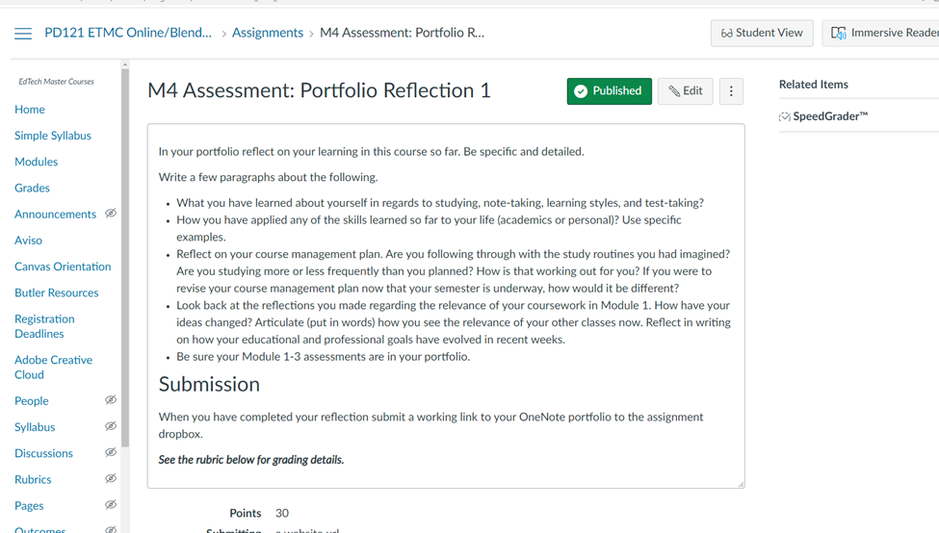
Introducing PDX

Slide 8
Any questions

Slide 9
Essential Question
How can developmental courses take full advantage of their position as first-semester courses?

Slide 10


Quick Write:
Collect your thoughts.
What first-year-experience or study skills content is already built in to your developmental courses? What, if anything, do you wish could be more explicitly addressed?

Slide 11




Slide 12


Lessons from BCCs first year experience courses
What students like
Opportunities for institutions and instructors
Overlapping content for repeated exposure

Slide 13
What students like
PRACTICAL – coursework for what purpose
Disciplinary matrix
Matriculation routes (AA, BA, MA, PhD/MD/JD)
The course emphasizes both the academic and the professional

Slide 14
Captive audience: Opportunities for teachers/institutions
Front line, first responder
Recruit students to field, pathways, and courses
Improved institutional IQ

Slide 15
Overlapping content for repeated exposure:
Marvelously interdisciplinary
Habit formation
Curve of forgetting
“Big” ideas
Growing metacognitive sophistication
Reflective study/post-game analysis
Mindset awareness
Learning preferences awareness

Slide 16
Essential Question
How can developmental courses take full advantage of their position as first-semester courses?

