Slide 1
Using Backward Design to Build Confidence and Empower Leaders

Slide 2
Corequisite model
EG 101(Comp. 1) → EG 060 (dev. course)
Developmental students attend EG 101 with traditional students and then follow same teacher into EG 060 immediately after.
Important: The two are separate courses with totally separate assignments for totally separate credit.
Some students may also take an additional reading course during the same term, but that course is not paired with the others.

Slide 3
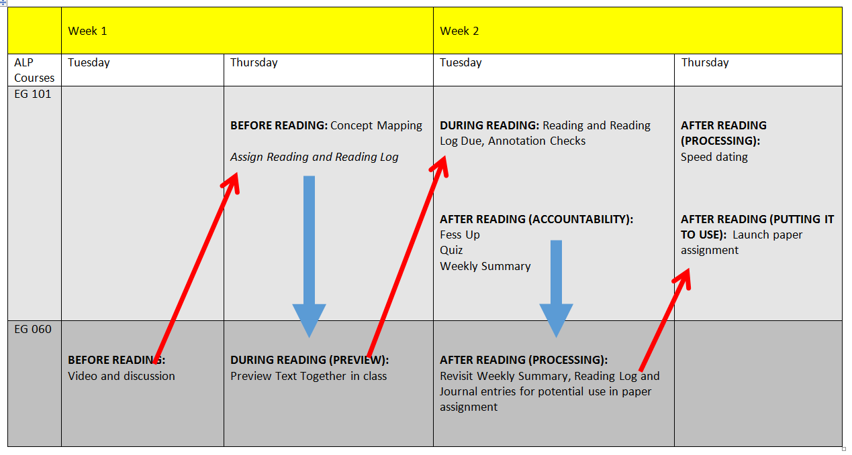
Wait…what is Backward Design?

Slide 4
Essential Questions
How can we use backward design in our paired developmental classes to build confidence and empower student leadership?
What causes students to feel confident and willing to risk standing out or [gasp] being wrong? What prevents it?

Slide 5
Quick Write:
Collect your thoughts.
How do your ALP students interact with and carry themselves among non-developmental students in the higher course? What differences, if any, do you notice between the two groups?

Slide 7
Backward Design in Four Spheres
Skills
Assignments
Instructional tactics/course procedures
Concepts

Slide 8
Skills
Introducing sources
Summarizing sources
Using quotations
Paragraphing
Using topic sentences
Writing thesis statements
Synthesizing sources
Leadership and empowerment

Slide 9
A quick peek at assignment types
Reading log sequence
Daily Summary Sequence
Short writing sequence

Slide 11
Assignments
060
Weekly Summary scaffold
Reading Log sequence
Short writing assignments
SWA: Brainology (Dweck)
Applying,
Introducing sources, paraphrasing, Summarizing,
SWB: Keystone Habits (Duhigg)
Using quotations, Topic
sentences, Applying
SWC: Nature Deficit Disorder
Finding a source, Synthesizing sources
Essay organization
101
Weekly Summary scaffold
Reading Log sequence
Essay #2
Essay #3
Essay #4
Essay #5
Leadership and empowerment

Slide 12
Instructional Tactics/Course Procedures
Reading Cycle
Reading Logs
Thought routines (OEQ, QSK, KWL etc.)
Encountering writing prompts
Paired Discussions
Academic scripts (model, model, model!)
Leadership and empowerment

Slide 13
Concepts
Sample unit: Language, Identity, and Education
Reading: Frederick Douglass, Malcolm X, Sojourner Truth
Wheel of Privilege
Social construction of identity
Academic Distinictions: wealth/class, sex/gender, etc.
Double consciousness
Code switching
Leadership and empowerment

Slide 14
Essential Questions
How can we use backward design in our paired developmental classes to build confidence and empower student leadership?
What causes students to feel confident and willing to risk standing out or [gasp] being wrong? What prevents it?

